Slide 1

AI AGENT FACTORY

Slide 2
Factory goals
Rapidly identify high-impact processes
We quickly focus AI on problems that actually matter to the bank.
Assemble reusable AI agents –
Build once, reuse everywhere — saving time, cost, and risk.
Enforce governance, security, observability
AI behaves like a regulated system, not a black box.
Deliver agents like internal products (not experiments)
If AI isn’t production-grade, it doesn’t belong in the bank.

Slide 3
High-Impact AI Agent Topics (Mass-Scale Use Cases)
Operations & Back Office (Immediate ROI)
Compliance, Risk & Audit (Regulatory-Grade)
Employee Productivity (Mass Adoption)
Technology & Engineering (Force Multiplier)
Customer & Business (Carefully Governed)

Slide 4
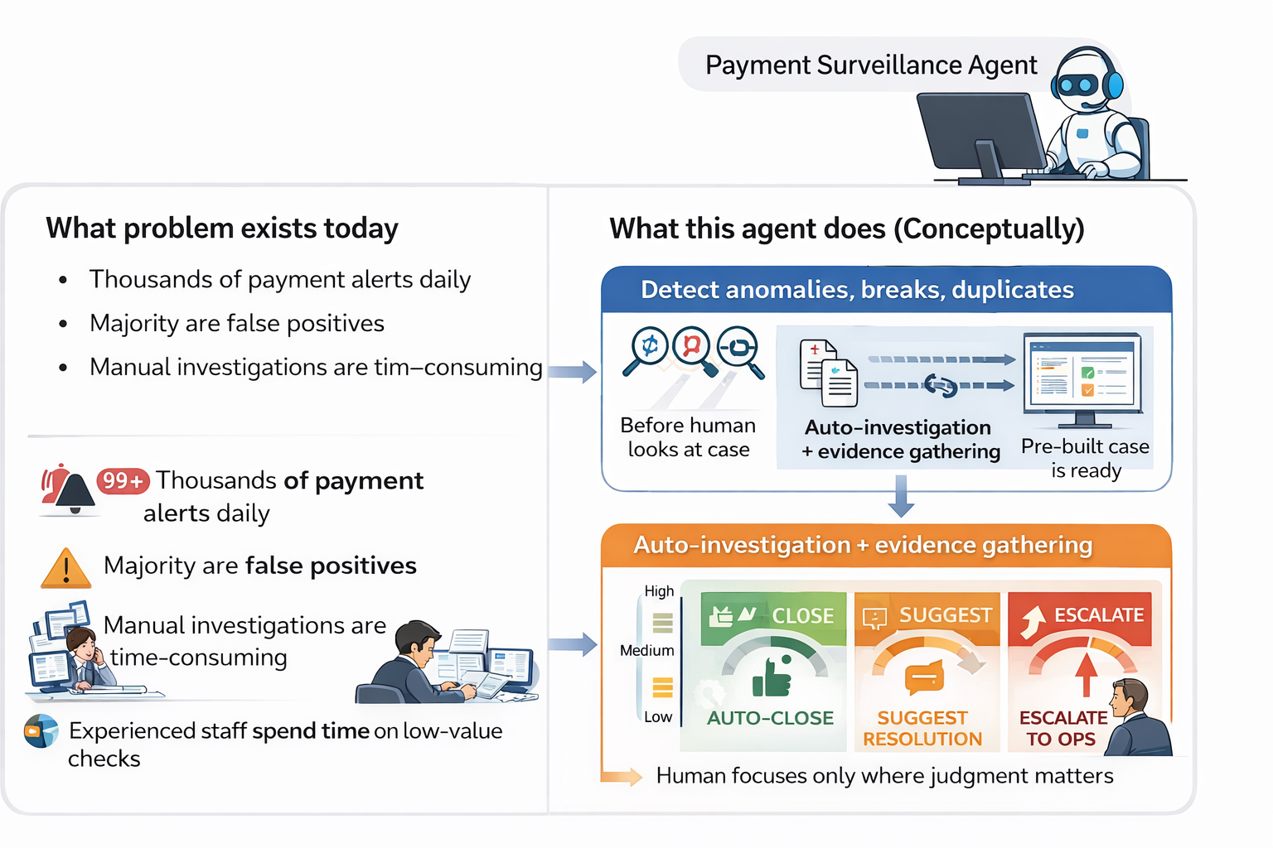
A. Operations & Back Office (Immediate ROI)
Payment Surveillance Agent
Detect anomalies, breaks, duplicates
Auto-investigation + evidence gathering
Escalation only when confidence < threshold

Slide 5
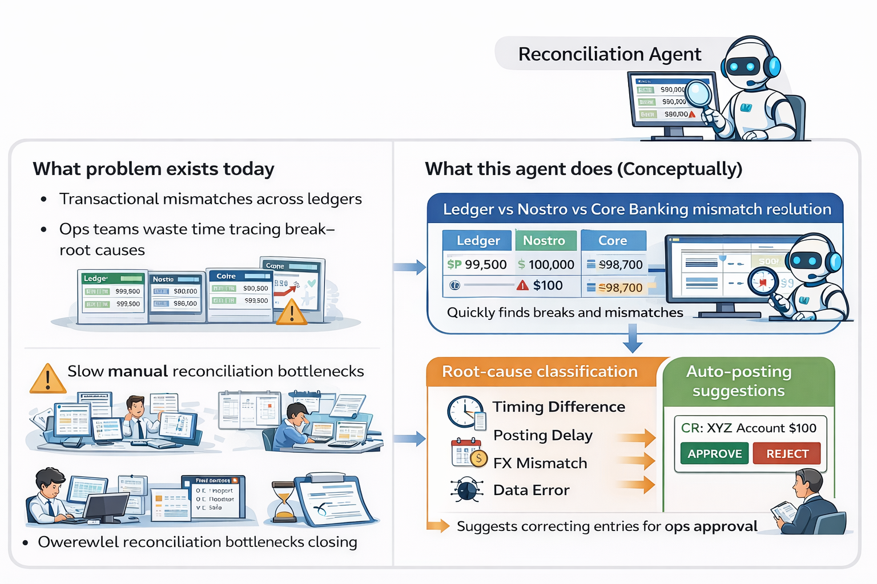
Reconciliation Agent
Ledger vs Nostro vs Core Banking mismatch resolution
Root-cause classification
Auto-posting suggestions

Slide 6
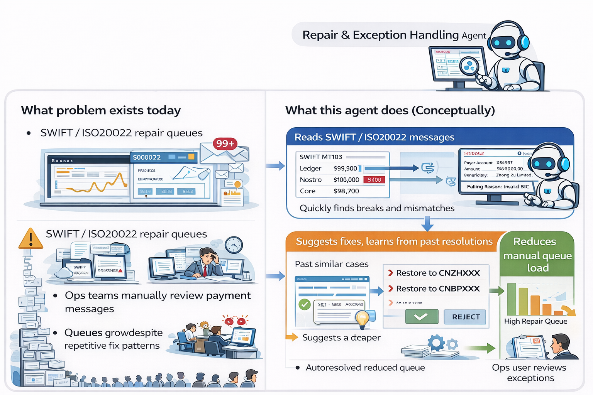
Repair & Exception Handling Agent
Reads SWIFT / ISO20022 messages
Suggests fixes, learns from past resolutions
Reduces manual queue load
👉 Impact: Helps thousands of ops users daily

Slide 7
B. Compliance, Risk & Audit (Regulatory-Grade)
Regulatory Change Impact Agent
Reads circulars, ECB / RBI / FCA updates
Maps changes to internal policies & systems
Produces impact reports
AML Case Pre-Assessment Agent
Summarizes alerts
Scores explainability
Prepares SAR draft (human approves)
Audit Evidence Collection Agent
Pulls logs, tickets, approvals
Creates audit-ready evidence packs

Slide 8
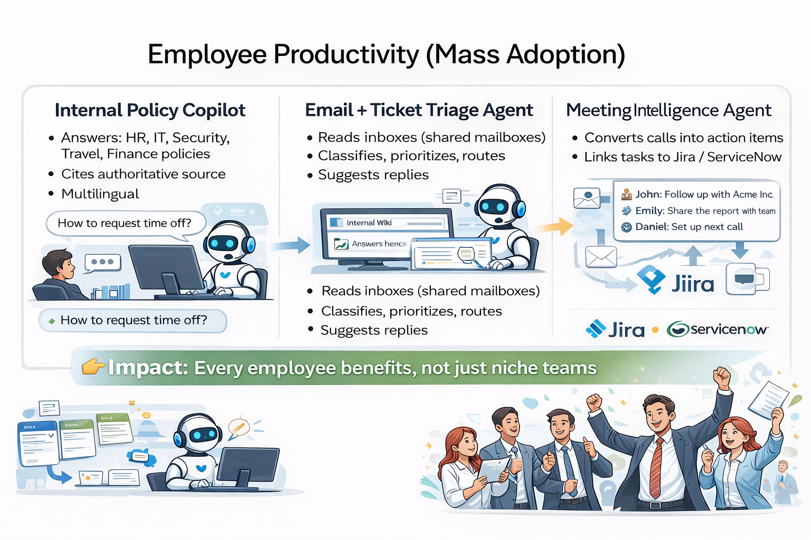
C. Employee Productivity (Mass Adoption)
Internal Policy Copilot
Answers: HR, IT, Security, Travel, Finance policies
Cites authoritative source
Multilingual
Email + Ticket Triage Agent
Reads inboxes (shared mailboxes)
Classifies, prioritizes, routes
Suggests replies
Meeting Intelligence Agent
Converts calls into action items
Links tasks to Jira / ServiceNow

Slide 9
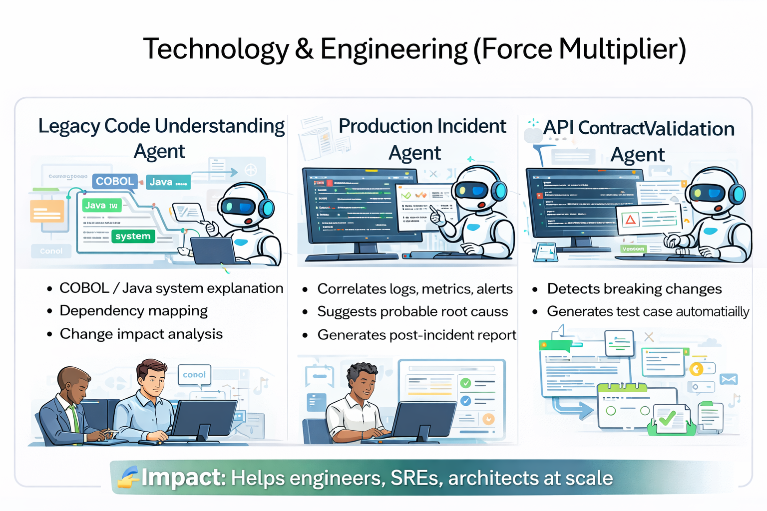
D. Technology & Engineering (Force Multiplier)
Legacy Code Understanding Agent
COBOL / Java system explanation
Dependency mapping
Change impact analysis
Production Incident Agent
Correlates logs, metrics, alerts
Suggests probable root cause
Generates post-incident report
API Contract Validation Agent
Detects breaking changes
Generates test cases automatically

Slide 10
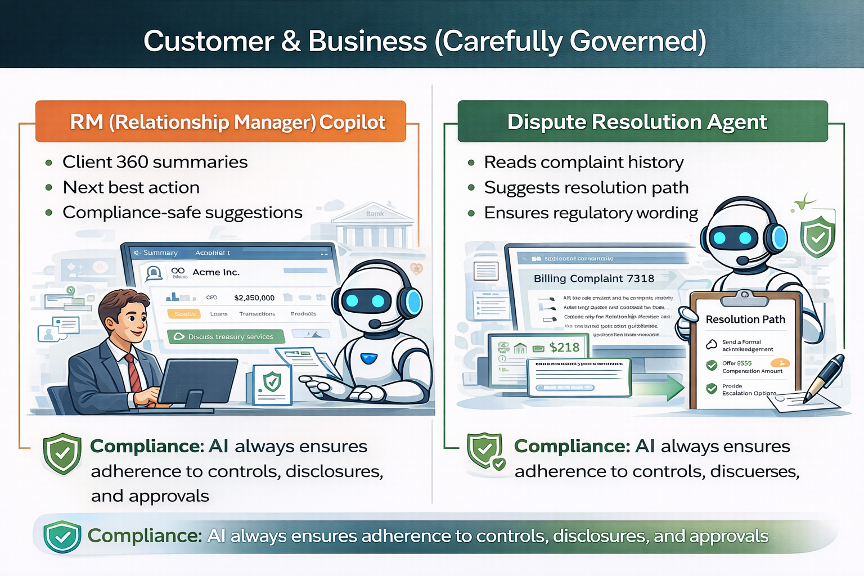
E. Customer & Business (Carefully Governed)
RM (Relationship Manager) Copilot
Client 360 summaries
Next best action
Compliance-safe suggestions
Dispute Resolution Agent
Reads complaint history
Suggests resolution path
Ensures regulatory wording

Slide 11
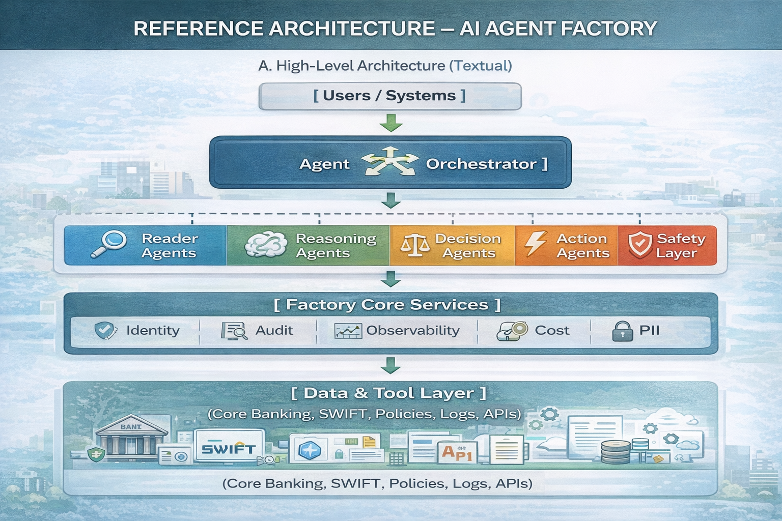

Slide 12
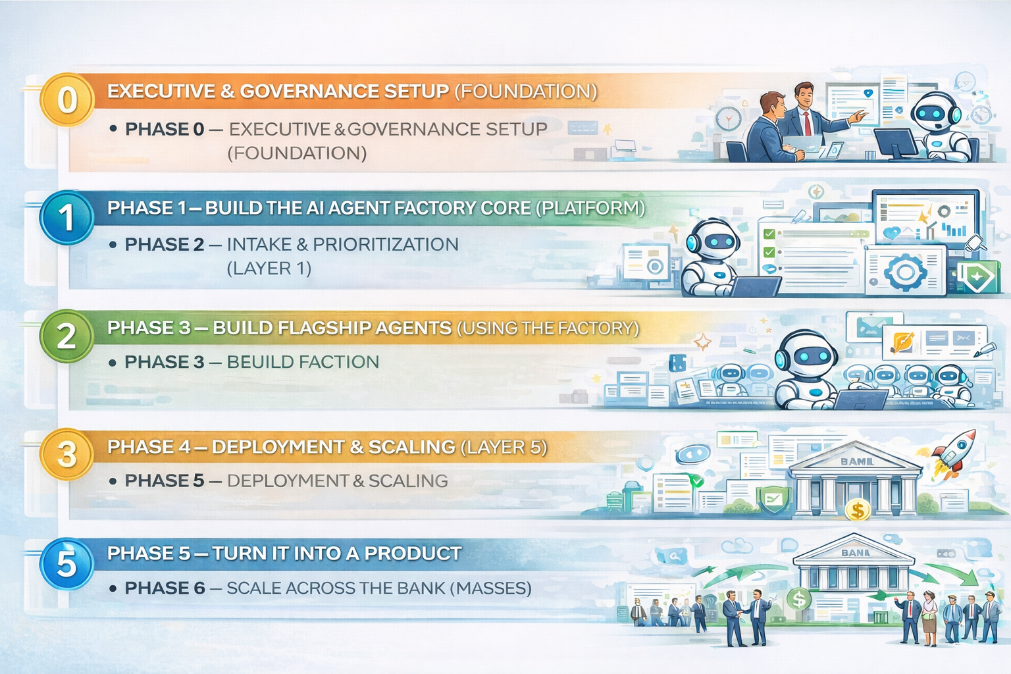

Slide 13

PHASE 0 — EXECUTIVE & GOVERNANCE SETUP (FOUNDATION)
Timeline: 2–4 weeks Goal: Make this a sanctioned enterprise capability, not an experiment
Step 0.1: Executive Sponsorship
Identify 1 Business sponsor (Ops / COO / Compliance)
Identify 1 Technology sponsor (CTO / CIO org)
Identify 1 Risk/Model Governance owner

Slide 14
PHASE 1 — BUILD THE AI AGENT FACTORY CORE (PLATFORM)
Timeline: 8–12 weeks Goal: Build once, reuse forever
This is where most banks fail by jumping directly to use cases.
Step 1.1: Create the Central Agent Factory Team
Step 1.2: Implement Core Factory Services (Core Services)
Step 1.3: Define Standard Agent Blueprint (Layer 2)

Slide 15
PHASE 2 — INTAKE & PRIORITIZATION (LAYER 1)
Timeline: 2–3 weeks (then continuous)
Step 2.1: Create Agent Intake Funnel
Step 2.2: Score Use Cases (Objective)
Step 2.3: Select 2–3 Flagship Agents

Slide 16
PHASE 3 — BUILD FLAGSHIP AGENTS (USING THE FACTORY)
Timeline: 8–12 weeks per wave
Step 3.1: Assemble Agents from Standard Blocks
Step 3.2: Embed Human-in-the-Loop
Step 3.3: Instrument Everything

Slide 17
PHASE 4 — DEPLOYMENT & SCALING (LAYER 5)
Timeline: Continuous
Step 4.1: Sandbox → Pilot → Production
Step 4.2: Feature Flags & Gradual Rollout
Step 4.3: Adoption via Embedding (Critical)

Slide 18
PHASE 5 — TURN IT INTO A PRODUCT (NOT A PROJECT)
Step 5.1
Product Operating Model
Step 5.2
Versioned Releases
Step 5.3
Measure What Matters

Slide 19

PHASE 6 — SCALE ACROSS THE BANK (MASSES)

